Slide 1
Transfer Learning versus Random Initialization
Isolating feature quality from trainable capacity in scene classification
Shriman Raghav Srinivasan · CS 5330 Pattern Recognition and Computer Vision · Prof. Bruce Maxwell · July 2026
Transfer learning reliably beats training from scratch, but the standard comparison moves two variables at once: the quality of the pretrained features and the number of parameters left trainable. This study adds a capacity-matched control, a randomly initialized network frozen at the same depth, so the two can be varied independently. On six-class scene classification with ResNet-18, pretrained features are worth 26.7 accuracy points once capacity is held fixed, while capacity on its own accounts for 18.
Notes:
SLIDE 1 — Title
Here's a claim you have heard a hundred times. Pretrained networks beat training from scratch.
It's true. It is also confounded, and almost nobody checks.
[pause]
Because the moment you freeze the early layers of a pretrained network, you have changed two things at the same time. You get better features. You also get a smaller optimization problem. Every paper that reports that comparison is reporting both effects as a single number, and then attributing the whole thing to the features.
So I built the experiment that pulls them apart. ResNet-18, six-class scene classification, three conditions. One of those conditions is a model that nobody would ever deploy on purpose, and that useless model is where the entire answer comes from.
I'm Shri. The short version is that it really is mostly the features, and by the end of this I can put a number on exactly how much.

Slide 2
CONTENTS AND CONTEXT
Agenda and Introduction
Pretrained backbones are the default for small vision datasets. This study asks what that default is actually buying.
Agenda
The practice
The task
The question
01
Introduction
Load ImageNet weights into a standard backbone, freeze the early layers and fine-tune the tail. Near-universal for datasets below a few thousand images.
Six-class natural scene classification: buildings, forest, glacier, mountain, sea and street. 14,034 training and 3,000 held-out test images on ResNet-18.
The practice demonstrably works. What makes it work? Genuinely better features, or simply a smaller optimization problem than training everything?
02
Problem Statement
03
Research Objectives
04
Literature Review
05
Methodology
06
Results
07
Discussion
08
Limitations
Both explanations predict exactly the same headline number, so the comparison everyone runs cannot separate them. Doing so requires a condition that moves one while holding the other fixed.
09
Conclusion
10
Future Work
11
Acknowledgments
12
References
13
Q&A
Notes:
SLIDE 2 — Agenda and Introduction
Quick map. Problem, objectives, prior work, method, then three slides of results, then what it means and what it doesn't.
[point: the three blocks]
Here's the setup. Loading ImageNet weights into a backbone, freezing the early layers and fine-tuning the tail is what essentially everyone does below a few thousand images. It is not a technique so much as a default.
The task is six-class natural scenes. Buildings, forest, glacier, mountain, sea, street. Fourteen thousand training images, three thousand held completely out.
And the default demonstrably works. My question is what makes it work. Genuinely better features, or just a smaller problem for the optimizer to solve?
[pause]
Both answers predict the same headline number. That's the whole difficulty, and it's what the next slide is about.

Slide 3
THE CONFOUND AND THE AIMS
Problem Statement and Research Objectives
Freezing the early layers changes two things at once, so the standard comparison cannot attribute the win to either.
OBSERVED
A pretrained, partly frozen network beats one trained from scratch.
Research objectives
FACTOR A
FACTOR B
O1
Quantify feature quality, capacity fixed
Feature quality
Trainable capacity
Pretrained-Frozen against the capacity-matched control.
The frozen weights already encode edges, textures and shapes learned from a million labeled images, before your data arrives.
Freezing also shrinks how many parameters the optimizer can move, which helps on 14k images whatever those weights mean.
O2
Quantify the contribution of capacity
The frozen random control against a fully trainable network.
O3
Locate where fine-tuning stops paying
Goal. Vary one at a time.
A freeze-depth sweep, linear probe to full fine-tuning.
O4
Measure the first layer's reach
Replace conv1 with a fixed Gabor bank, then unfreeze upward.
Notes:
SLIDE 3 — Problem Statement and Research Objectives
Let me make the trap concrete.
[point: the observed band]
This is the observation everyone reports. A pretrained, partly frozen network beats one trained from scratch. Now, two completely different explanations sit underneath it.
[point: Factor A]
Factor A is feature quality. Those frozen weights already encode edges, textures and shapes learned from a million labeled images, before your data ever arrives.
[point: Factor B]
Factor B is trainable capacity. Freezing also shrinks how many parameters the optimizer can move, and on fourteen thousand images a smaller model is simply easier to fit, whether the frozen weights are meaningful or complete noise.
[pause]
Both predict a win. So when the pretrained model wins, you cannot say which one earned it. The goal is a design that moves one at a time.
[point: objectives]
Hence four objectives. O1 measures feature quality with capacity nailed down. O2 measures capacity alone. O3 asks where fine-tuning stops paying. O4 asks how far up the influence of the first convolution reaches.

Slide 4
PRIOR WORK
Literature Review
Four established findings frame the study; one gap motivates it.
Pretrained features transfer off the shelf
Razavian et al., CVPR-W 2014 · Kornblith et al., CVPR 2019
A frozen backbone plus a linear classifier is a strong baseline across tasks, and ImageNet accuracy tracks transfer accuracy closely.
Transferability is layer-dependent
Yosinski et al., NeurIPS 2014
Early layers learn generic edge and texture filters that transfer widely; later layers specialize to the source task.
Random weights are a legitimate baseline
Jarrett et al., ICCV 2009 · Saxe et al., ICML 2011
Untrained convolutional filters still yield usable representations, because some architectures are frequency selective by construction.
Transfer gains can be over-parameterization
Raghu et al., NeurIPS 2019
In medical imaging much of the apparent benefit is attributable to model size rather than to genuinely reused features.
Gap. No prior study holds trainable capacity fixed while varying only the quality of the frozen features on a single architecture.
Notes:
SLIDE 4 — Literature Review
Four things are already established. One thing isn't.
Frozen pretrained features plus a linear classifier is a strong baseline across tasks, and ImageNet accuracy predicts transfer accuracy. Razavian and Kornblith.
Transferability is layer-dependent. Early layers learn generic edge and texture filters that transfer almost anywhere; later layers specialize to whatever they were trained on. Yosinski.
Random weights are a legitimate baseline, not a strawman. Untrained filters still produce usable representations, because the architecture itself does real work. Jarrett and Saxe. That result is what licenses my control condition.
And transfer gains can be over-parameterization rather than feature reuse. Raghu found precisely that in medical imaging. That is the closest prior work to what I'm doing.
[pause]
[point: Gap]
And here is what nobody has done. No study holds trainable capacity fixed while varying only the quality of the frozen features, on one architecture. That gap is the whole project.

Slide 5
DESIGN, ARCHITECTURE AND PROTOCOL
Methodology
Three conditions on one architecture. Only the treatment of the early block θf changes; everything else is held constant.
CONDITION
EARLY BLOCK ΘF
LATE BLOCK ΘT
TRAINABLE SHARE
Pretrained-Frozen
ImageNet weights, frozen
trained · 8,396,806
75%
Random-Frozen control
random weights, frozen
trained · 8,396,806
75%
Random-Full
random weights, trained
trained · 11,179,590
100%
PT-F vs R-F isolates feature quality, capacity matched R-F vs R-FL isolates trainable capacity, both random
Protocol and setup
conv1 + bn1
layer1
layer2
layer3
layer4
fc (6-class)
Stratified 90/10 split · 12,631 / 1,403
Train 3 conditions × 3 seeds (42, 100, 2026)
SGD 1e-3, mom 0.9, wd 1e-4, batch 32
θf frozen · 2,782,784 · BN in eval()
θt trainable · 8,396,806
Early stop on val loss, patience 5
requires_grad = False does not freeze BatchNorm: running statistics keep updating on every forward pass, so a block believed to be frozen quietly drifts. Both frozen conditions hold BatchNorm in eval mode; Random-Full updates normally, by design.
Evaluate once on 3,000 test images
Report mean ± std across seeds
Notes:
SLIDE 5 — Methodology
The way you close that gap is by adding a condition that makes no sense on its own.
[point: table rows]
Pretrained-Frozen: ImageNet weights, frozen, train the tail. Random-Full: everything random, everything trainable.
And then the strange one in the middle. Random-Frozen. Random weights up front, frozen at their random values, with the exact same trainable tail as the pretrained model. You are deliberately freezing garbage and training a classifier on top of it. Nobody would ever ship this.
[point: the share bars]
But look at those two bars. The top two have identical trainable parameters, down to the individual weight. So Pretrained-Frozen against Random-Frozen isolates feature quality. And Random-Frozen against Random-Full isolates capacity.
Two comparisons. One variable each.
[point: layer strip]
Concretely the cut is conv1 through layer3 frozen, layer4 and the classifier trainable.
[slow]
And one detail here nearly cost me the study. Setting requires_grad to False does not freeze batch normalization. The running statistics keep updating on every forward pass, so a block you believe is frozen is quietly drifting underneath you. Both frozen conditions hold batch norm in eval mode for the entire run.
[point: protocol]
Everything else is constant, and the test set is opened exactly once, after every decision has already been made.

Slide 6
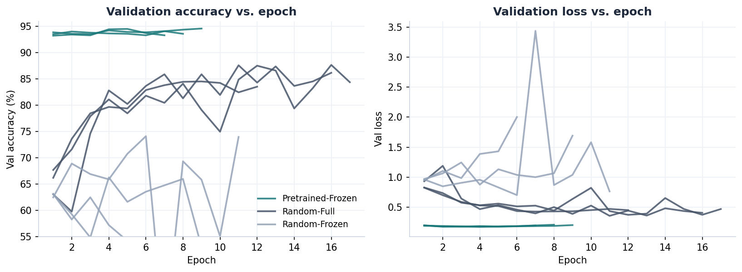
RESULTS
Results I: Accuracy, Cost and Convergence
Capacity-matched, pretraining is worth 26.7 points, at a quarter of the wall clock. Mean of three seeds.
TEST ACCURACY
Pretrained-Frozen
93.3%
Random-Full
84.7%
Random-Frozen
66.5%
CONVERGENCE AND COST
Pretrained-Frozen
8.0 epochs
103 s
Random-Frozen
8.7 epochs
113 s
Pretrained-Frozen is above 93% at epoch one and flat by epoch four. Random-Full climbs for 12 to 17 epochs to a lower plateau, and Random-Frozen never settles: the optimizer has capacity but nothing useful to work with.
Random-Full
15.0 epochs
426 s
PT-F vs R-F: +26.7 points. Identical trainable parameters, data and recipe; the only difference is whether the frozen weights came from ImageNet. R-F to R-FL recovers 18 points through capacity alone, and still finishes nine points short.
Notes:
SLIDE 6 — Results I
Here is the payoff.
[point: bars]
Pretrained-Frozen, 93.3 percent. Trained from scratch, 84.7. And the control, frozen random features, 66.5.
Now the comparison this entire design was built for. Pretrained-Frozen against Random-Frozen. Identical trainable parameters, identical data, identical recipe, identical everything. The only difference between those two runs is whether the frozen weights came from ImageNet or from a random number generator.
[pause]
Twenty-six point seven points.
[pause]
That number is pretraining by itself, with capacity held fixed. No naive comparison can produce it, which is the point.
The second comparison, 66.5 climbing to 84.7, is capacity on its own. About eighteen points. So capacity is real. It's just the smaller of the two effects.
[point: cost table]
And it isn't free either. Scratch needs fifteen epochs against eight, roughly four times the wall clock, and still finishes nine points short.
[point: curves]
The curves show why the gap opens so fast. Pretrained-Frozen is already above 93 percent at epoch one, before it has learned anything worth mentioning, and it's flat by epoch four. Random-Full grinds upward for twelve to seventeen epochs to a lower plateau. Random-Frozen is the noisy band along the bottom that never settles: plenty of capacity, nothing useful to work with.

Slide 7
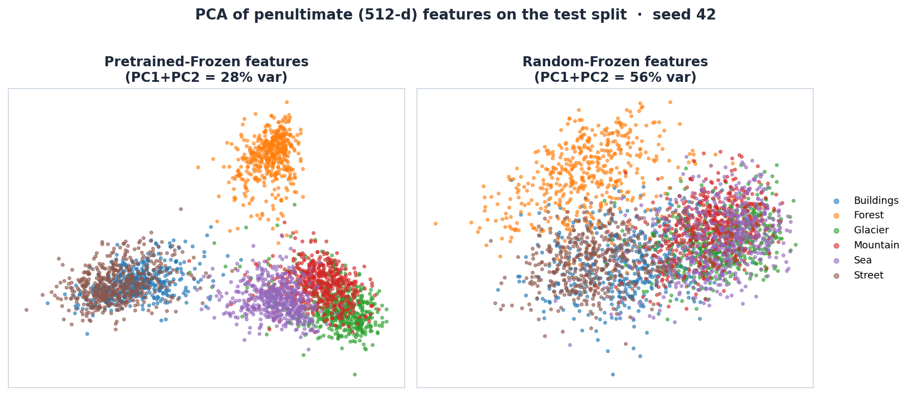
RESULTS
Results II: Feature Space and Error Analysis
The class overlaps in the pretrained feature space are exactly the confusions the classifier makes.
PRETRAINED-FROZEN CONFUSION · SEED 100
B
F
G
M
Se
St
B
408
0
0
0
1
28
F
0
471
0
1
0
2
G
1
4
458
71
16
3
M
1
2
28
484
9
1
Se
2
0
2
3
503
0
St
26
0
0
2
0
473
rows true, columns predicted
Glacier ↔ Mountain · 71 and 28
Shared snow, ridges and rock texture.
PCA of the 512-d penultimate activations, test split, seed 42. Pretrained features fall into clean clusters before the classifier acts on them; the random frozen features stay entangled apart from forest.
Buildings ↔ Street · about 27 each way
Streets contain buildings, and the reverse.
Same pairs in every condition
Larger under random init, structurally identical.
Notes:
SLIDE 7 — Results II
So why are the pretrained features better? Rather than argue about it, let's look at them.
[point: left panel]
These are the 512-dimensional activations from the layer just before the classifier, projected down to two dimensions. On the left, pretrained-frozen. Six clean clusters, and remember, this is before the classifier does anything at all.
Now look at which clusters touch. Glacier, mountain and sea bleed together here. Buildings and street bleed together there. Hold that thought.
[point: right panel]
On the right, random-frozen. Same projection, same images. Forest pulls away slightly, which is fair, it's the most distinctive class. Everything else is one undifferentiated cloud. One classifier is handed structure. The other is handed mush and asked to draw boundaries in it.
[point: matrix]
And here's the payoff. Two clusters carry almost all of the error. Glacier confused with mountain, 71 one way and 28 back. Buildings with street, about 27 each direction. Every other cell is essentially empty.
Those are exactly the pairs that overlapped in the feature space. The representation predicted the failure modes before the classifier ever ran. And the same two clusters dominate in all three conditions, just far larger under random init, which tells me the errors track genuine visual ambiguity in the data rather than a broken training loop.

Slide 8
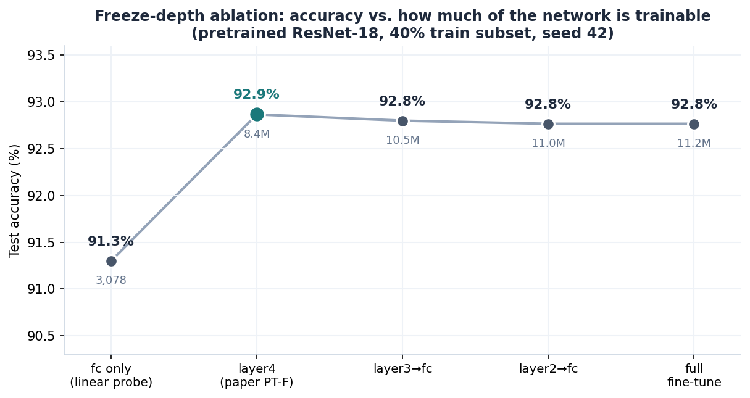
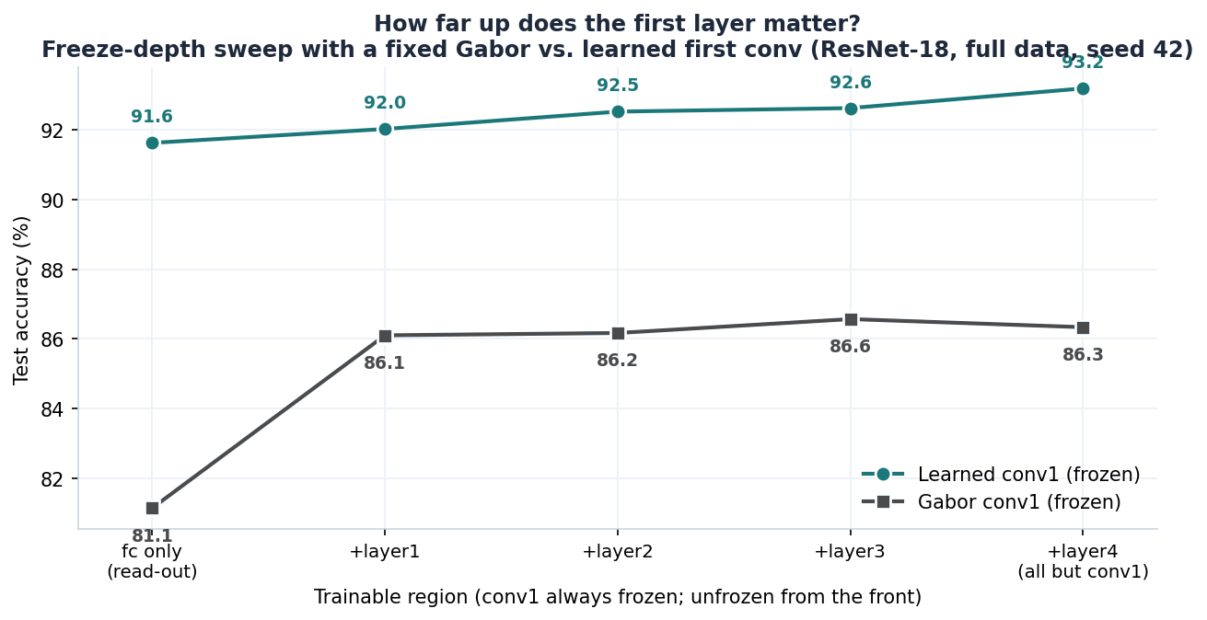
RESULTS
Results III: Ablation and Extension
Most of pretraining's value needs almost no fine-tuning, and a fixed filter bank cannot reconstruct the learned first layer.
Freeze depth · 40% training subset, seed 42
Fixed Gabor conv1 · full data, seed 42
A bare linear probe on frozen features already reaches 91.3% from 3,078 trainable parameters. Unfreezing layer4 adds 1.6 points. layer3, layer2 and full fine-tuning are all flat at 92.8% with up to 3.6× the parameters, so the elbow is exactly at layer4.
conv1 swapped for a fixed bank of 8 orientations × 4 frequencies × 2 phases. The read-out sits 10 points low; unfreezing layer1 alone returns 5 of them and layer2 to layer4 add nothing. Seven points never return.
Notes:
SLIDE 8 — Results III
Two follow-up experiments.
[point: left plot]
The first. I cut at layer4 because that's standard practice, and standard practice is not evidence, so I swept it. Far left is a bare linear probe: three thousand trainable parameters, everything else frozen, already at 91.3 percent. Unfreezing layer4 buys the last point and a half.
And then the curve simply stops. layer3, layer2, the whole network, all landing on the same number at three and a half times the parameters. The elbow is exactly where I cut, and nearly all of pretraining's value is available with almost no fine-tuning.
[point: right plot]
The second came from a question Professor Maxwell asked. Suppose you don't learn the first layer at all. I replaced conv1 with a fixed Gabor bank, froze it permanently, and asked how far up the network re-adaptation has to reach before the damage is absorbed.
A read-out alone sits ten points low. Unfreeze just the very next stage, layer1, and five of those points come straight back. Then nothing: layer2, layer3, layer4 add essentially zero. So the first layer's influence reaches about one stage up and is absorbed there.
[slow]
But here's the part I did not expect. Seven points never come back. Even with every single layer above conv1 free to retrain, the entire rest of the network is allowed to compensate, and it cannot.

Slide 9
INTERPRETATION AND SCOPE
Discussion and Limitations
What the two clean comparisons establish, and what this design does not.
Discussion
Limitations
Feature quality outweighs capacity
One dataset, one architecture
26.7 points from pretrained features against 18 from full capacity. Both matter; the representation matters considerably more.
The 26.7-point figure is not claimed to generalize across domains.
Three seeds, no significance test
The value sits in the generic early layers
Gaps far exceed the within-condition spread, but no test is run.
A linear probe already reaches 91.3% and unfreezing past layer4 adds nothing, matching the layer-dependent transferability of Yosinski et al.
No data augmentation
Omitted deliberately; absolute accuracies sit below tuned baselines.
Learned first-layer filters are not reconstructible
Ablation on a 40% subset
Run on reduced data for tractability. Read the shape, not the values.
A 7-point Gabor gap that full downstream retraining cannot close qualifies the random-filter results of Jarrett et al. and Saxe et al. at depth.
Gabor bank untuned
The 7-point residual is therefore an upper bound on the gap.
Practical consequence
The control is not a method
On a small dataset with a tight compute budget, freeze deep and fine-tune little.
Random-Frozen holds capacity fixed. It is not a way to train anything.
Notes:
SLIDE 9 — Discussion and Limitations
So what does this mean.
Feature quality outweighs capacity: 26.7 points against 18. Both are real. The representation is the bigger lever.
The value sits in the generic early layers. A linear probe gets 91.3 percent and unfreezing past layer4 adds nothing, which is the layer-dependence Yosinski reported, now measured with capacity controlled.
And the learned first-layer filters are not reconstructible. That seven-point gap qualifies Jarrett and Saxe at greater depth than they tested. Fixed filters get you a long way, not all the way.
Practically: small dataset, tight budget, freeze deep and fine-tune little.
[point: limitations]
Now what this does not establish. One dataset and one architecture, so the 26.7 figure is a measurement here, not a law. Three seeds with no significance test, though the gaps far exceed the spread. No augmentation, deliberately, which puts my absolute numbers below tuned baselines. The ablation ran on a 40 percent subset, so read the shape of that curve and not its values. The Gabor bank is untuned, so seven points is an upper bound on that gap. And the control is a control. It is not a method.

Slide 10
FINDINGS AND NEXT STEPS
Conclusion and Future Work
What the capacity-matched design establishes, and the four extensions it makes straightforward.
Conclusion
Future work
i.
Pretraining is feature quality, not parameter count
Test the ratio off-distribution
Capacity-matched, pretrained features are worth +26.7 points over random ones.
Repeat the comparison on a domain far from ImageNet, where Raghu et al. found size dominating.
ii.
Capacity helps, and cannot close the gap
Separate depth from capacity
Replace the random control with a parameter-matched shallow network.
Full capacity from scratch reaches 84.7%: nine points short, at four times the compute.
Scale the pretraining set
iii.
For small data, transfer learning wins outright
Sweep pretraining corpus size: does the 26.7-point gap grow or saturate?
Best accuracy and fastest convergence, and the ablation says minimal fine-tuning.
Push the reconstruction limit
Tune the bank and try other fixed bases. Is the gap specific to Gabor?
The random-frozen control is what makes the first point a measurement rather than an impression.
Notes:
SLIDE 10 — Conclusion and Future Work
Three findings.
One. Pretraining is feature quality, not parameter count. Capacity-matched, plus 26.7 points.
Two. Capacity helps, and it cannot close the gap. Full capacity from scratch gets you to 84.7 percent. Nine points short, at four times the compute.
Three. For small data on a tight budget, transfer learning wins outright, on accuracy and on speed, and the ablation says you barely have to fine-tune to collect most of it.
[pause]
And the reason the first of those is a number instead of an opinion is a condition nobody would ever deploy. Freezing random garbage is a useless model. It was the single most valuable run in the study.
[point: future work]
Four extensions. The one that matters most is testing that ratio off-distribution, on a domain far from ImageNet, because that is precisely where Raghu found model size dominating instead. The others separate depth from capacity, scale the pretraining corpus, and push on whether that first-layer gap is specific to Gabor filters or true of fixed bases in general.

Slide 11
CREDITS AND BIBLIOGRAPHY
Acknowledgments and References
Peer-reviewed venues only.
Acknowledgments
Prof. Bruce Maxwell
CS 5330, Khoury College. His question about how far the first layer’s influence reaches became the Gabor experiment in Results III.
Intel Image Classification dataset
Natural scene imagery across six categories, distributed publicly via Kaggle.
PyTorch and torchvision
ResNet-18 implementation and the ImageNet-pretrained weights used throughout.
References
[1]
J. Deng, W. Dong, R. Socher, L.-J. Li, K. Li and L. Fei-Fei. ImageNet: A Large-Scale Hierarchical Image Database. CVPR, 2009.
[2]
K. Jarrett, K. Kavukcuoglu, M. Ranzato and Y. LeCun. What is the Best Multi-Stage Architecture for Object Recognition? ICCV, 2009.
[3]
A. M. Saxe et al. On Random Weights and Unsupervised Feature Learning. ICML, 2011.
[4]
A. S. Razavian, H. Azizpour, J. Sullivan and S. Carlsson. CNN Features Off-the-Shelf: An Astounding Baseline. CVPR Workshops, 2014.
[5]
J. Yosinski, J. Clune, Y. Bengio and H. Lipson. How Transferable Are Features in Deep Neural Networks? NeurIPS, 2014.
[6]
S. Ioffe and C. Szegedy. Batch Normalization: Accelerating Deep Network Training by Reducing Internal Covariate Shift. ICML, 2015.
[7]
K. He, X. Zhang, S. Ren and J. Sun. Deep Residual Learning for Image Recognition. CVPR, 2016.
[8]
S. Kornblith, J. Shlens and Q. V. Le. Do Better ImageNet Models Transfer Better? CVPR, 2019.
[9]
M. Raghu, C. Zhang, J. Kleinberg and S. Bengio. Transfusion: Understanding Transfer Learning for Medical Imaging. NeurIPS, 2019.
Notes:
SLIDE 11 — Acknowledgments and References
Quick thanks. Professor Maxwell, whose question about how far the first layer's influence reaches turned into the Gabor experiment you just saw. The Intel scenes dataset, distributed publicly through Kaggle. And PyTorch and torchvision for the backbone and the pretrained weights.
References are on screen, all peer-reviewed venues.

Slide 12
QUESTIONS
Thank you
Capacity-matched, pretrained features are worth 26.7 accuracy points. The control that establishes it is a model nobody would ever deploy.
PRESENTER
COURSE
INSTITUTION
Shriman Raghav Srinivasan
CS 5330 · Prof. Bruce Maxwell
Khoury College, Northeastern University
Notes:
SLIDE 12 — Q&A
That's the talk.
Capacity-matched, pretrained features are worth 26.7 accuracy points. And the thing that lets me say that as a measurement rather than an impression is a model nobody would ever deploy.
Thank you. Happy to take questions.

